Slide 1
Issey Miyake
Audience360 Post Campaign Report
4th Nov - 23rd Dec 2024

Slide 2
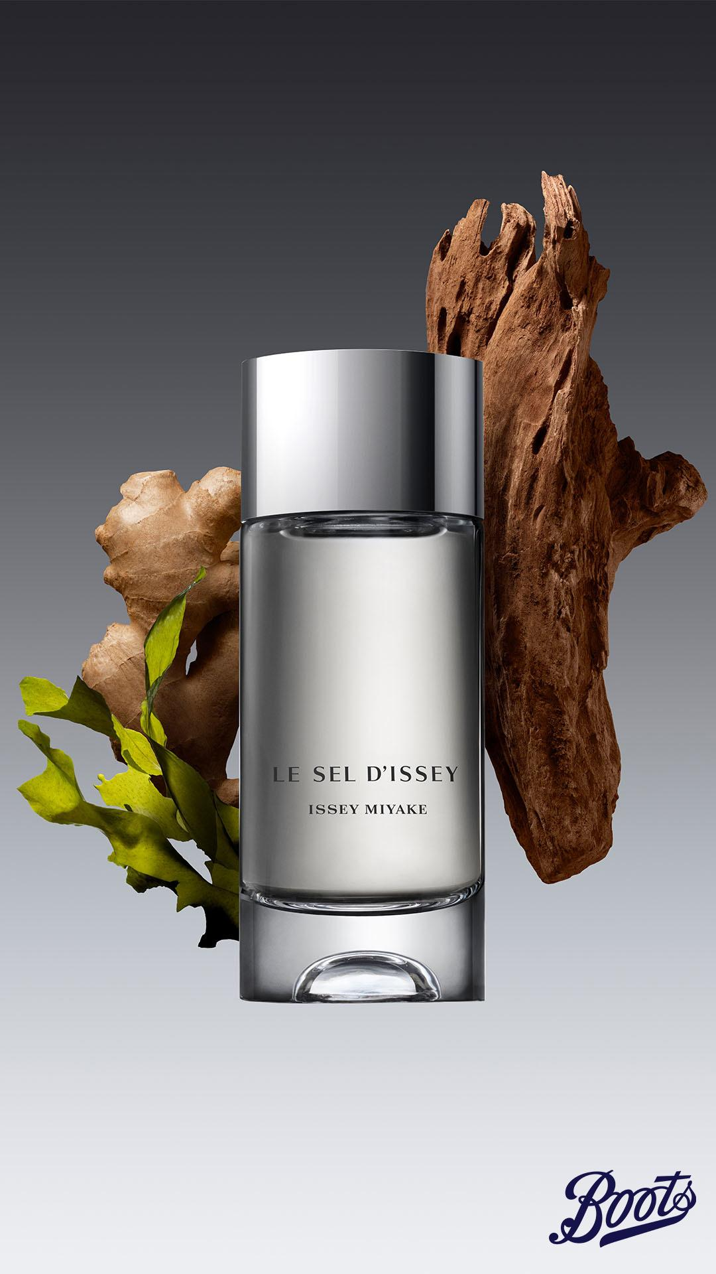
01
Campaign brief summary
02
Post campaign report
Overall campaign performance
Audience breakdown
Creative analysis
03
Learnings & Recommendations
04
Appendix
Meta performance
Pinterest performance

Slide 3
01
Campaign Brief Summary
OUR APPROACH

Slide 4
Campaign Summary
Brand:
Issey Miyake
Campaign:
Le Sel
Flight Dates:
4th November - 23rd December 2024
Channels:
Meta & Pinterest
Objective
To drive consideration and conversion of Issey Miyake Le Sel NPD.
Primary KPIs:
Click Through Rate (CTR)
Cost Per Mille (CPM)
Secondary KPIs:
Return on Ad Spend (ROAS)
Return on Investment (ROI)
Sales volume
Further measurement:
New-to-brand & new-to-category measurement
Notes:
Updated

Slide 5

The campaign overperformed on reach and engagement, however struggled to achieve an overall positive ROI
Objective: CTR
The campaign overachieved on estimated clicks (+129%) showing this campaign was highly engaged. Current brand shoppers proved to be the most engaged audience while the Male Fine Fragrance Propensity Model showed the most engagement out of the acquisitional audiences.
Objective: Sales, Revenue & ROI
Sales saw a strong 110% increase from mid-campaign until post campaign, however still resulted in an overall campaign ROI of £0.42. Current Issey Miyake shoppers were the top performing segment with an overall ROI of £1.63 , however were challenging to target at scale with an expensive Net CPM £13.05.
Objective: CPM and Reach
The overall campaign over-delivered on unique users. We reached +289% AdCard users on Meta due to a cost-efficient CPM of £5.31 (vs £5.98). This indicates that we were able to reach more prospective Boots shoppers and drive consideration of the Issey Miyake Le Sel range. Pinterest drove a higher CPM than expected and therefore more expensive to show the ad on platform to a larger scale, although we still over delivered on reach.

Slide 6
ROI increased 110% from mid-campaign until post-campaign after making optimisations
ROI: £0.20
ROI:£0.42
Mid-campaign on
26th November 2024
Optimisations on 10th December 2024
Post campaign on
20th Janurary 2025
Campaign started on 4th November 2024
Suggest to add in new audiences
Shifted primary objective from sales to consideration and keep conversion as secondary objective
Added in new audiences
Extended the campaign from 10th December to 23rd December.

Slide 7
02
Post Campaign Report
The following analysis is based on exposed audience.

Slide 8
Overall Campaign Performance
The following analysis is based on exposed audience.

Slide 9
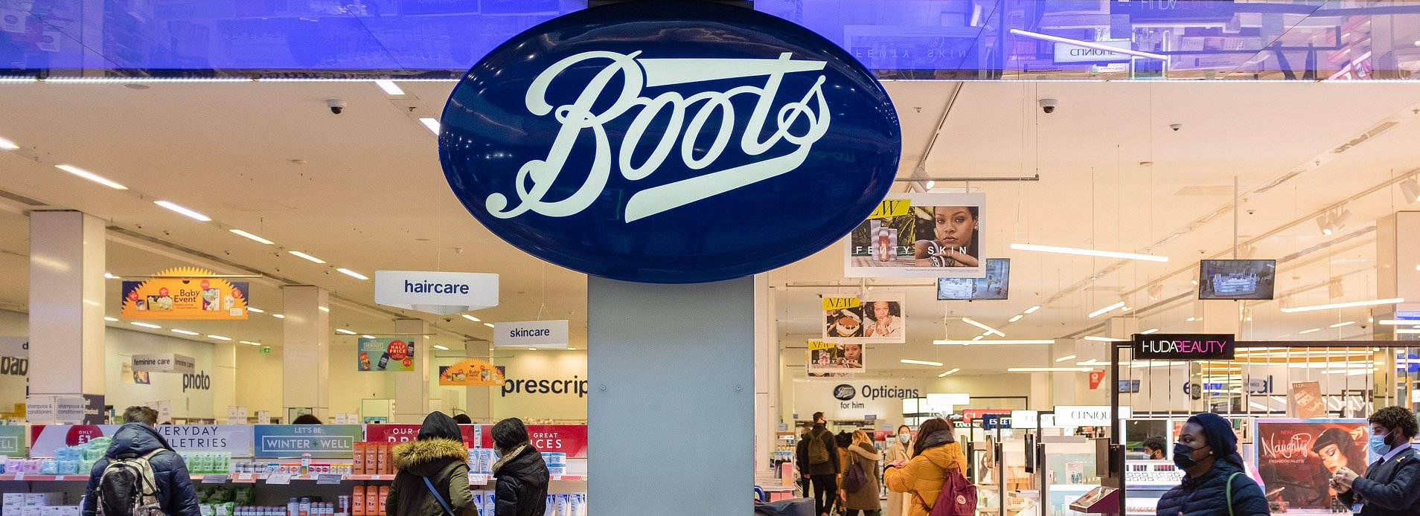







Total Campaign Summary
Delivery Performance
GROSS
SPEND
IMPRESSIONS
UNIQUE REACH
FREQUENCY
CLICKS
CTR
Net CPM
£49,211
6,236,825
1,212,512
5
13,417
0.21%
£6.85
Estimated:
£50,000
Estimated:
5,852,842
Estimated:
325,156
Estimated:
18
Estimated:
5,853
Estimated:
0.10%
Estimated:
£5.98
Notes:
check on frequency

Slide 10
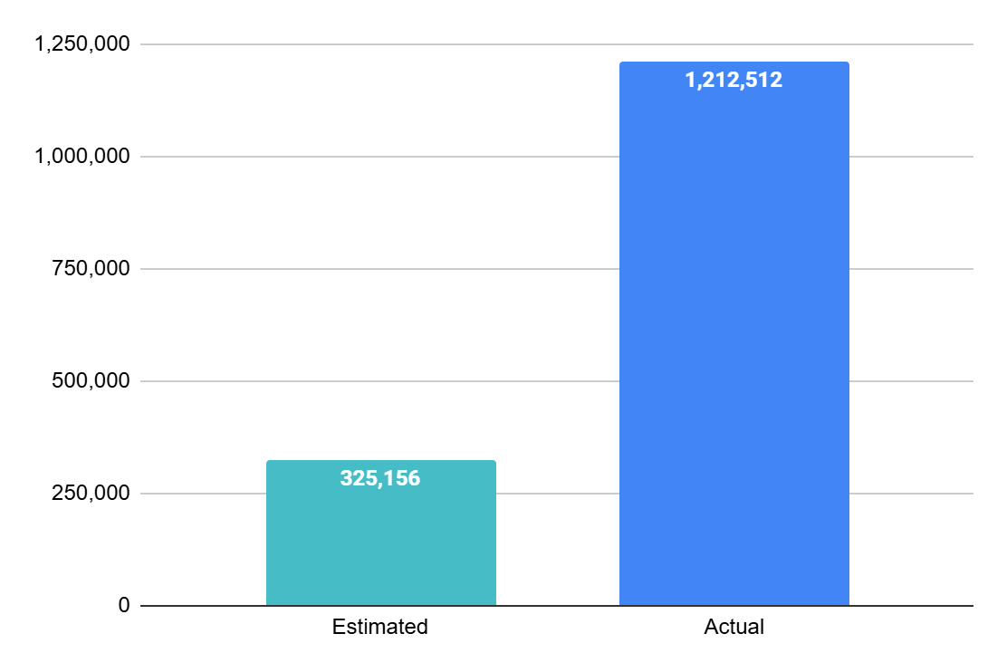
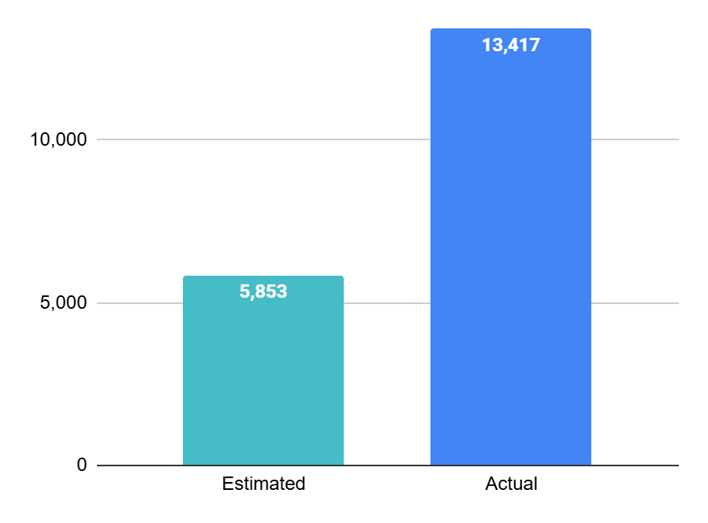
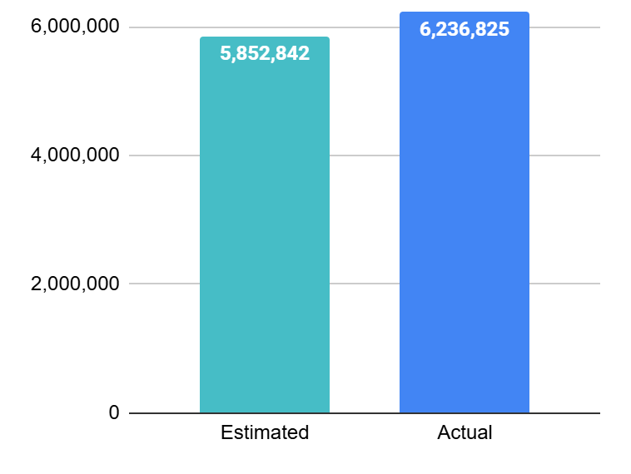
The campaign reached more unique users and generated more link clicks and impressions than expected, indicating stronger-than-anticipated audience scale and engagement.
+6.5%
+472%
+129%
IMPRESSIONS
Reach
Clicks
Notes:
OK

Slide 11
Pinterest drove a stronger ROI, while Meta drove a more cost-efficient CPM and enabled the campaign to deliver more impressions than expected
Reach
Impressions
CTR
Net CPM
Link Clicks
Gross Spend
Brand Revenue
Product Revenue*
Overall
1,212,512
6,236,825
0.21%
£6.85
13,417
£49,211
£20,788.58
£0.60
£0.42 ROI
£1,412.47
£0.05 ROAS
£0.03 ROI
Reach
Impressions
CTR
Net CPM
Link Clicks
Gross Spend
Brand Revenue
Product Revenue*
Meta
1,114,577
5,802,372
0.22%
£5.31
13,007
£43,999
£13,989.71
£0.45 ROAS
£0.32 ROI
£1,412.47
£0.05 ROAS
£0.03 ROI
Reach
Impressions
CTR
Net CPM
Link Clicks
Gross Spend
Brand Revenue
Product Revenue
Pinterest
97,935
434,453
0.09%
£8.40
410
£5,212
£6,798.87
£1.86 ROAS
£1.30 ROI
N/A
*Product measurement is only available on Meta.

Slide 12
Issey Miyake Shoppers prefers to shop online, which is slightly higher than other A360 premium fragrance campaigns
Metrics | Total Issey Miyake
Gross Spend | £49,211
Brand revenue | £20,788.58
Brand ROAS | £0.60
Brand ROI | £0.42
Brand online revenue | £11,902.96
Brand instore revenue | £8,885.62
Brand online % of sales | 57.26%
Brand instore % of sales | 42.74%
Benchmark in premium fragrance category:
Online: 47%
Instore: 53%
Notes:
updated

Slide 13
Audience Breakdown
The following analysis is based on exposed audience.

Slide 14
Audience Performance breakdown
Audience Segment | Net Spend | Impressions | Reach | Frequency | Clicks | CTR | Net CPM | Brand Revenue | Brand ROAS
Current Female Fragrance Shoppers | £11,626.83 | 2,131,796 | 263,518 | 8 | 4,669 | 0.22% | £5.45 | £3,252.98 | £0.20
Current Issey Miyake Shoppers | £4,198.75 | 321,659 | 11,811 | 27 | 1,323 | 0.41% | £13.05 | £9,793.52 | £1.63
Current Male Fragrance Shoppers | £7,776.74 | 1,435,188 | 166,741 | 9 | 3,206 | 0.22% | £5.42 | £1,937.47 | £0.18
Female Competitor Shoppers | £2,168.03 | 1,131,467 | 724,671 | 2 | 1,141 | 0.10% | £1.92 | £450.40 | £0.15
Female fine fragrance propensity model | £1,441.41 | 256,349 | 81,599 | 3 | 583 | 0.23% | £5.62 | £297.99 | £0.15
Female premium cosmetics propensity model | £2,169.60 | 398,538 | 95,900 | 4 | 749 | 0.19% | £5.44 | £181.19 | £0.06
Female premium gift shoppers | £1,404.15 | 206,532 | 50,070 | 4 | 475 | 0.23% | £6.80 | £1,311.43 | £0.65
Lapsed Issey Miyake Shoppers | £2,842.42 | 242,424 | 7,537 | 32 | 974 | 0.40% | £11.72 | £3,523.60 | £0.87
Male Competitor Shoppers | £272.81 | 36,347 | 9,946 | 4 | 94 | 0.26% | £7.51 | £40.00 | £0.11
Male fine fragrance propensity model | £113.26 | 16,185 | 3,836 | 4 | 49 | 0.30% | £7.00 | £0.00 | £0.00
Male premium cosmetics propensity model | £316.41 | 44,868 | 10,866 | 4 | 111 | 0.25% | £7.05 | £0.00 | £0.00
Male premium gift shoppers | £117.60 | 15,472 | 3,901 | 4 | 43 | 0.28% | £7.60 | £0.00 | £0.00

Slide 15
36%
of Issey Miyake shoppers were new to brand
The campaign succeeded in driving both New-To-Brand (NTB) and New-To-Category (NTC) shoppers across our targeted audiences
7%
of Issey Miyake shoppers were new to category

Slide 16
Issey Miyake Brand Shoppers drove the strongest ROI and engagement, whilst Female Premium Gift Shoppers drove the strongest ROI among all non-brand audiences.
Current & Lapsed Brand Shoppers
Current Issey Miyake shoppers drove a ROI of £1.63 and CTR 0.41%. This was followed by Lapsed Issey Miyake shoppers who drove a ROI of £0.87 and CTR of 0.40%.
​
Acquisitional Shoppers
Female Premium Gift Shoppers drove the strongest ROAS among all non-brand audiences. This audience drove a ROI of £0.65 making it the top-performing sales driving audience amongst the acquisition segments. Therefore we recommend to continue targeting this segment in future Issey Miyake campaigns with conversion objectives.
The Male Fine Fragrance Propensity Model generated the highest CTR of 0.30% of non-brand audiences, however didn’t convert any sales. Male Competitor Shoppers generated the highest NTB sales of Male audiences while achieving the third highest CTR across all acquisitional audiences. Due to a more expensive CPM, this audience was challenging to scale.
​
Online purchase behaviour
Issey Miyake Shoppers preferred to shop online over instore, meaning we should consider this online purchase behaviour into planning for future ROI driving campaigns. We overlaid online shoppers to all the newly added audiences and there is a clear preference of online shopping for Issey Miyake shoppers, proven by over 55% of revenue coming from online stores.

Slide 17
Creative Analysis
The following analysis is based on exposed audience.

Slide 18

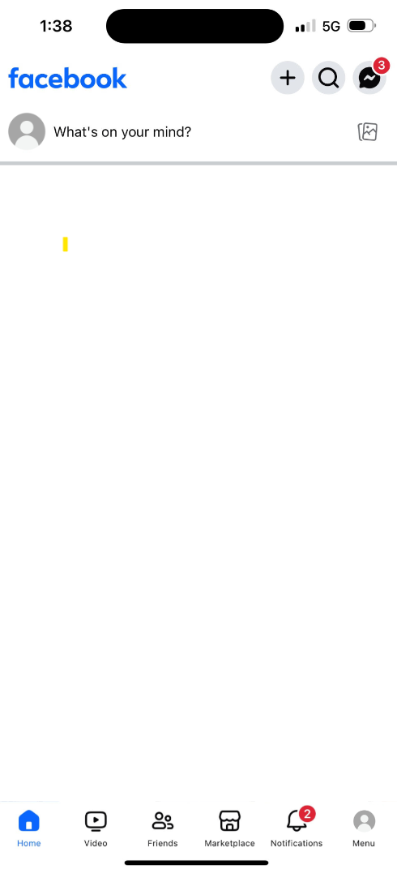
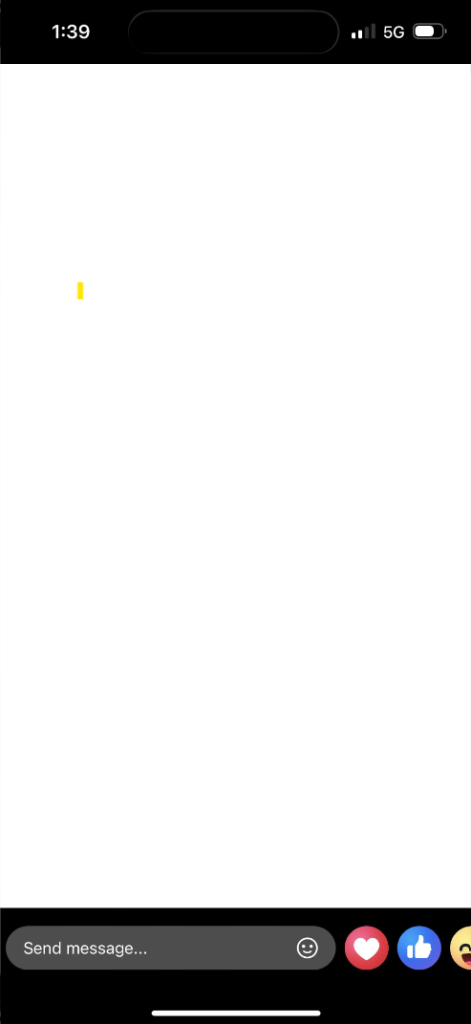
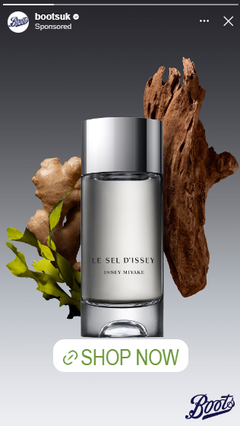
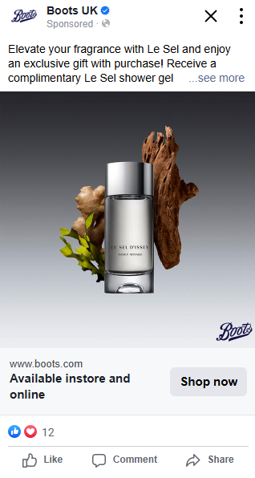
Creatives Analysis
There was only one set of creatives being included in this campaign. Therefore, there is limited creative learnings from this campaign.
Recommendation for future campaigns:
Include a variety of formats in future campaigns, including video and statics for link ads, carousels and collection ads.
For future NPD campaigns, we recommend supplying assets that highlight product benefits and USPs.
Consider to incorporate event-specific messaging, such as Black Friday and other special occasions, into future campaigns to enhance relevance and engagement
In-feed ad
1:1
Story ad
9:16

Slide 19
Learnings & recommendations for future activations

Slide 20
Learnings & considerations to take forward into future campaign planning | Targeting, Phasing & Creative
Learning: Pinterest drove a stronger ROI performance, whilst Meta saw a stronger CTR and more cost efficient CPM. This performance is a consistent trend across A360 premium fragrance campaigns.
Recommendation:
Given the channels’ different strengths for premium fragrance campaigns, continue activating a multi-channel approach for future campaigns with a similar campaign objective.
Learning: Issey Miyake shoppers prefers to shop online across Boots.
Recommendation:
Consider this online purchase behaviour while planning for future campaign.
Continue to overlay of online active membership segment towards audiences.
Learning: ROI is yet to be positive this time. We need to build awareness among Boots prospective shoppers, and to build foundation for future sales campaigns.
Recommendation:
Consider following a phased approach with a longer overall campaign period. Phase 1 to drive awareness and warm leads and Phase 2 to drive sales. We have seen increase in sales performance on acquisitional audiences between Phase 1 & 2 in previous A360 campaigns.
Learning: There was only one set of creatives being included in this campaign. We couldn’t further optimise the campaign at creative level.
Also, Black Friday influenced our audience behaviour, who showed interest in browsing products, but not yet converting, proven by strong CTR.
Recommendation:
Include a variety of formats in future campaigns, including video and statics for link ads, carousels and collection ads.
Consider to incorporate event-specific messaging, such as Black Friday and other special occasions, into future campaigns to enhance relevance and engagement

Slide 21
Appendix

Slide 22
Meta Campaign Performance
The following analysis is based on exposed audience.

Slide 23
Meta Campaign Summary
Delivery Performance
GROSS
SPEND
IMPRESSIONS
UNIQUE REACH
FREQUENCY
CLICKS
CTR
Net CPM
£43,999
5,802,372
1,114,577
5
13,007
0.22%
£5.31
Estimated:
£44,000.00
Estimated:
5,150,501
Estimated:
286,138
Estimated:
18
Estimated:
4,682
Estimated:
0.10%
Estimated:
£5.98

Slide 24
How many Brand sales did our Meta campaign drive?
Metrics | Total Issey Miyake
Gross Spend | £43,999
Brand revenue | £13,989.71
Brand ROAS | £0.45
Brand ROI | £0.32
Brand online revenue | £8,343.18
Brand instore revenue | £5,646.53
Brand online % of sales | 59.64%
Brand instore % of sales | 40.36%
Notes:
updated

Slide 25
How many Featured product sales did our Meta campaign drive?
Metrics | Total Issey Miyake FSKUs
Gross Spend | £43,999
FSKU revenue | £1,412.47
FSKU ROAS | £0.05
FSKU ROI | £0.03
FSKU online revenue | £1,077.22
FSKU instore revenue | £335.25
FSKU online % of sales | 76.26%
FSKU instore % of sales | 23.74%
*Featured product: Le Sel 50ml & Le Sel 100ml
Notes:
updated

Slide 26
Audience Performance breakdown
Audience Segment | Net Spend | Impressions | Reach | Frequency | Clicks | CTR | Net CPM | Brand Revenue | Brand ROI
Current Female Fragrance Shoppers | £9,999.90 | 1,936,209 | 206,672 | 9 | 4,498 | 0.23% | £5.16 | £1,610.04 | £0.11
Current Issey Miyake Shoppers | £3,882.35 | 307,454 | 9,053 | 34 | 1,279 | 0.42% | £12.63 | £7,195.34 | £1.30
Current Male Fragrance Shoppers | £6,999.58 | 1,333,267 | 137,793 | 10 | 3,131 | 0.23% | £5.25 | £1,055.14 | £0.11
Female Competitor Shoppers | £2,096.58 | 1,120,312 | 721,734 | 2 | 1,131 | 0.10% | £1.87 | £324.40 | £0.11
Female fine fragrance propensity model | £1,188.65 | 214,136 | 70,242 | 3 | 555 | 0.26% | £5.55 | £145.99 | £0.08
Female premium cosmetics propensity model | £1,857.87 | 347,901 | 82,956 | 4 | 706 | 0.20% | £5.34 | £95.20 | £0.04
Female premium gift shoppers | £1,152.95 | 194,477 | 47,896 | 4 | 442 | 0.23% | £5.93 | £0.00 | £0.00
Lapsed Issey Miyake Shoppers | £2,821.11 | 238,952 | 6,641 | 36 | 970 | 0.41% | £11.81 | £3,523.60 | £0.88
Male Competitor Shoppers | £272.31 | 36,260 | 9,921 | 4 | 94 | 0.26% | £7.51 | £40.00 | £0.11
Male fine fragrance propensity model | £93.80 | 13,064 | 3,108 | 4 | 47 | 0.36% | £7.18 | £0.00 | £0.00
Male premium cosmetics propensity model | £316.41 | 44,868 | 10,866 | 4 | 111 | 0.25% | £7.05 | £0.00 | £0.00
Male premium gift shoppers | £117.60 | 15,472 | 3,901 | 4 | 43 | 0.28% | £7.60 | £0.00 | £0.00

Slide 27
Pinterest Campaign Performance
The following analysis is based on exposed audience.

Slide 28
Pinterest Campaign Summary
Delivery Performance
GROSS
SPEND
IMPRESSIONS
UNIQUE REACH
FREQUENCY
CLICKS
CTR
Net CPM
£5,212.72
434,453
97,935
4
410
0.09%
£8.40
Estimated:
£6,000
Estimated:
702,341
Estimated:
39,018
Estimated:
18
Estimated:
702
Estimated:
0.10%
Estimated:
£5.98

Slide 29
How many Brand sales did our Pinterest campaign drive?
Metrics | Total Drunk Elephant
Gross Spend | £5,212.72
Brand revenue | £6,798.87
Brand ROAS | £1.86
Brand ROI | £1.30
Brand online revenue | £3,559.78
Brand instore revenue | £3,239.09
Brand online % of sales | 52.36%
Brand instore % of sales | 47.64%

Slide 30
Audience Performance breakdown
Audience Segment | Net Spend | Impressions | Reach | Frequency | Clicks | CTR | Net CPM | Brand Revenue | Brand ROI
Current Female Fragrance Shoppers | £1,626.93 | 195,587 | 56,846 | 3 | 171 | 0.09% | £8.32 | £1,642.94 | £0.71
Current Issey Miyake Shoppers | £316.40 | 14,205 | 2,758 | 5 | 44 | 0.31% | £22.27 | £2,598.18 | £5.75
Current Male Fragrance Shoppers | £777.16 | 101,921 | 28,948 | 4 | 75 | 0.07% | £7.63 | £882.33 | £0.80
Female Competitor Shoppers | £71.45 | 11,155 | 2,937 | 4 | 10 | 0.09% | £6.41 | £126.00 | £1.23
Female fine fragrance propensity model | £252.76 | 42,213 | 11,357 | 4 | 28 | 0.07% | £5.99 | £152.00 | £0.42
Female premium cosmetics propensity model | £311.73 | 50,637 | 12,944 | 4 | 43 | 0.08% | £6.16 | £85.99 | £0.20
Female premium gift shoppers | £251.20 | 12,055 | 2,174 | 6 | 33 | 0.27% | £20.84 | £1,311.43 | £3.65
Lapsed Issey Miyake Shoppers | £21.31 | 3,472 | 896 | 4 | 4 | 0.12% | £6.14 | £0.00 | £0.00
Male Competitor Shoppers | £0.50 | 87 | 25 | 3 | 0 | 0.00% | £5.75 | £0.00 | £0.00
Male fine fragrance propensity model | £19.46 | 3,121 | 728 | 4 | 2 | 0.06% | £6.24 | £0.00 | £0.00
Male premium cosmetics propensity model | £0.00 | 0 | 0 | - | 0 | - | - | £0.00 | -
Male premium gift shoppers | £0.00 | 0 | 0 | - | 0 | - | - | £0.00 | -

Slide 31
Thank you.

